Slide 1

(SOC501) Sociology: Theory and Methods
Universal laws and context
Amine Sijilmassi
amine.sijilmassi@um6p.ma

Slide 2


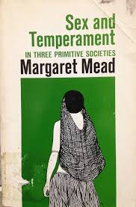
The debate
Are there general laws in social science? Or is it that context matters too much: a social law in one context cannot be applied in the other?
At first sight: social science might seem like it’s leaning heavily towards emphasizing context! In fact, one of the founding gestures of social science is precisely to show that what feels eternal and natural actually is contextual
Norbert Elias: « Civilization process »
Margaret Mead: the variability of gender roles
Philippe Ariès
Variability can even serve as a disciplinary divide where social science handles « context »: e.g. the sex vs. gender distinction

Slide 3
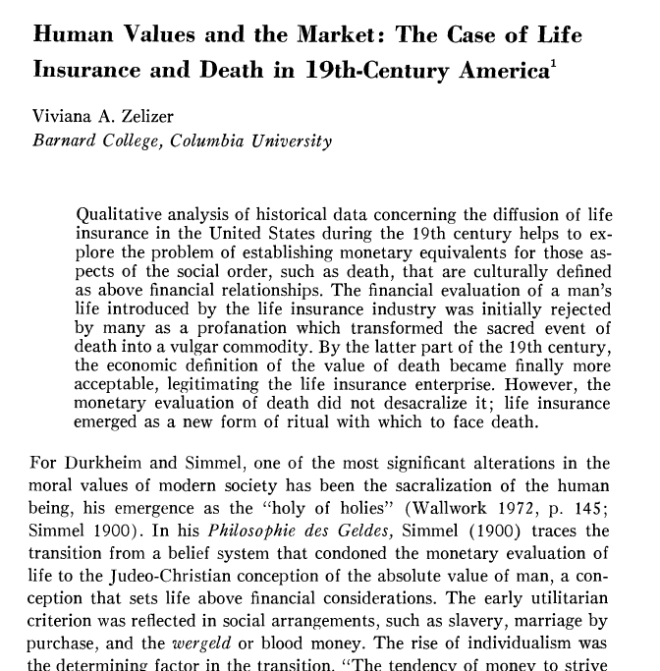
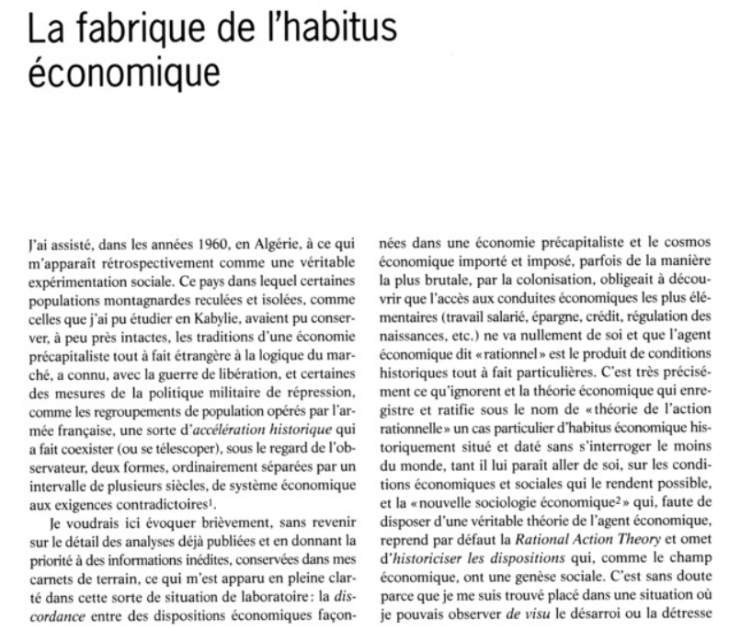
NB: to a large extent, the « embededness » critique of Homo Oeconomicus are contextual critiques, in the sense that they highlight that the « decontextualized » rational actor either doesn’t exist, or is itself constructed

Slide 4

Passeron’s arguments
He starts from the standard Popperian definition of science: a statement is scientific if it can be falsified by observations.
He argues that sociology is not a science, because social science concepts are contextual and historically situated. Think about Bourdieu’s theory for instance: « working class », « school system », « cultural capital »… are all concepts that only make sense in Western societies in the 1960s.
Likewise, the observed phenomena are contextual, in the sense that they cannot be replicated. E.g. « Schools perpetuate class inequality ». You can observe that this is true, but to extract a general law, you’d need to show that this work, for instance, in 2026 Italy, or 2000 Morocco. But so many things change across this situation that making the same observation is impossible (e.g. maybe the concept of « school », or of « class » means smth completely different then)
Because refuting a universal law by observation is impossible, then sociology cannot be a « science » in the Popperian sense
Sociology can still extract patterns about a specific context

Slide 5
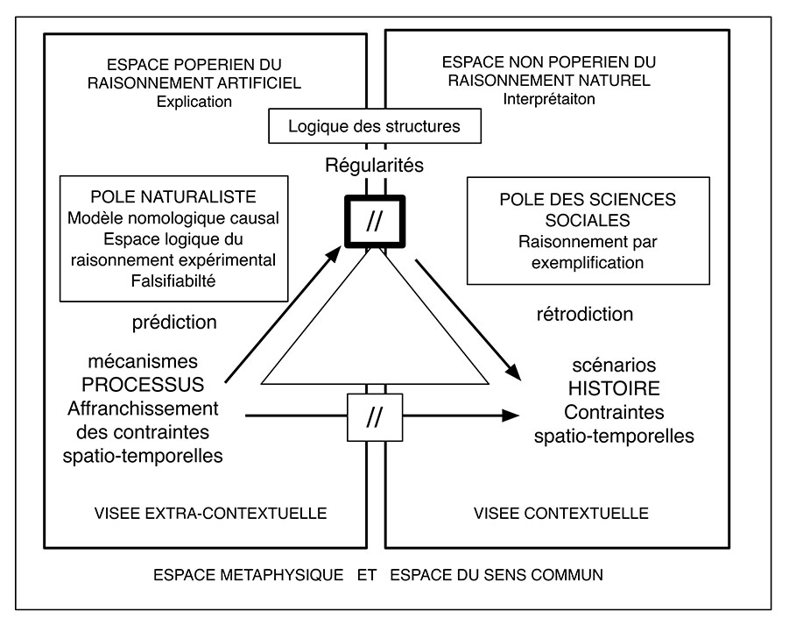

Slide 6
Example of conceptual difficulty: the definition of kinship

Slide 7
Hamilton's rule
If rb > c
  organisms are better off cooperating: cooperation toward kins will be favored by natural selection
  b = the benefit given to the recipient
  c = the cost of cooperation for the cooperator
  r = genetic relatedness between the cooperator & the recipient
See Hamilton, W. D. (1964). The genetical evolution of social behaviour. II. Journal of theoretical biology
Notes:
Amine

Slide 8
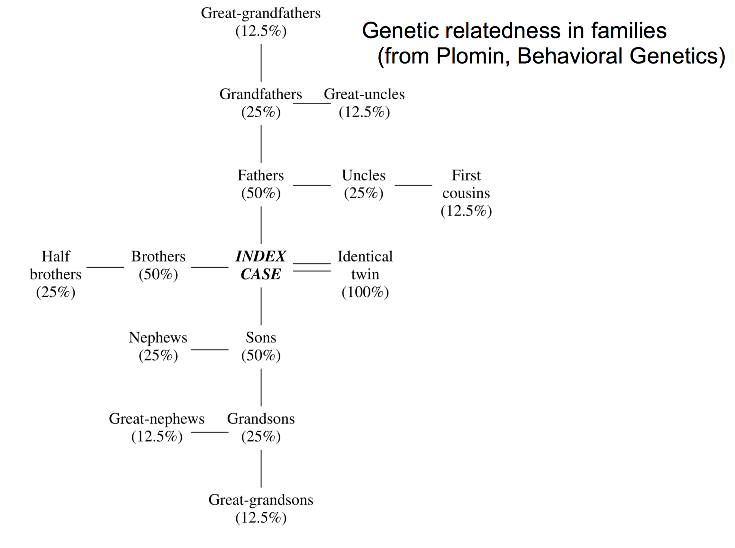
“I against my brother. I and my brother against my cousin. I, my brother, and my cousin against the world”
“I would gladly give up my life for two brothers or eight cousins.”

Slide 9
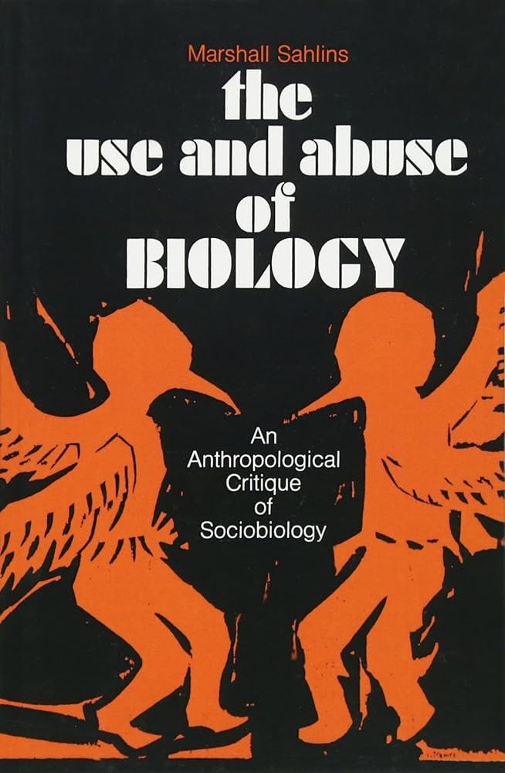
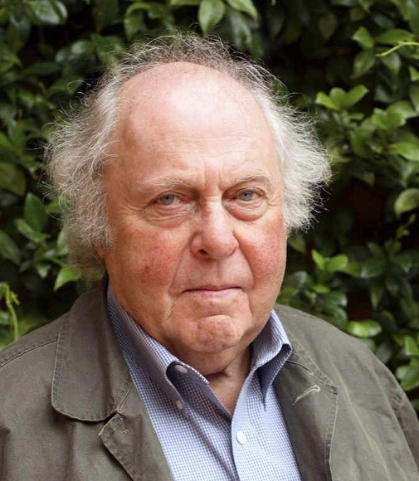
A critique of kin altruism: what about fictive kinship?
“... there is not a single system of marriage, postmarital residence, family organization, interpersonal kinship, or common descent in human societies that does not set up a different calculus of relationship and social action than is indicated by the principles of kin selection.” (Sahlins, 1976)

Slide 10
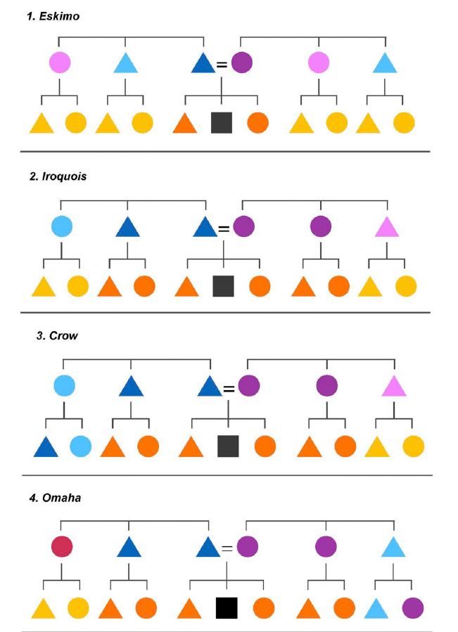
Kinship systems are extremely variable across cultures!!

Slide 11
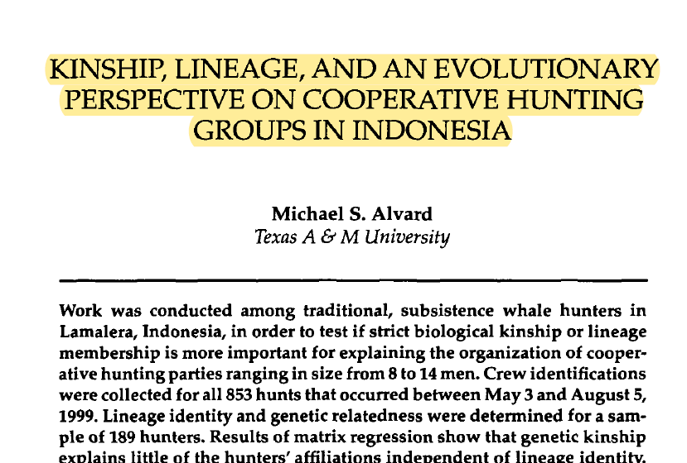
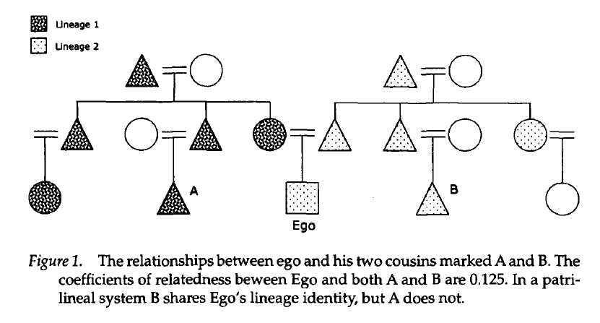
An example: patrilineal descent societies
Patrilineal descent = your group identity is defined by the group of your father.
Ex: if your father is from group A and your mother is from group B, then you belong to group A
Alvard, M. S. (2003). Kinship, lineage, and an evolutionary perspective on cooperative hunting groups in Indonesia. Human Nature, 14, 129-163.

Slide 12

But social science has a rich history of searching for universal laws!
Marx: the idea that the history of human societies in the history of class struggles
As early as Durkheim: analyzing ethnographies of Australian Aborigines, he seeks to provide a universal definition and explanation of religion. He finds it not in the belief in supernatural agents, but in the distinction between the sacred and the profane that binds a whole community…
Religion = “a unified system of beliefs and practices relative to sacred things, that is to say, things set apart and forbidden — beliefs and practices which unite into one single moral community called a Church, all those who adhere to them”

Slide 13
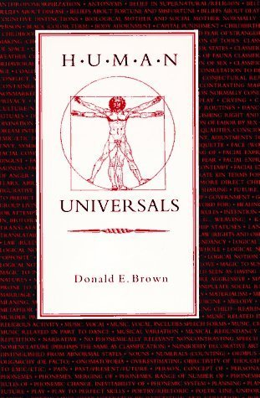
The benefits of extracting universal laws
Most obvious… explain universal patterns
Some patterns are « universal » in the statistical sense: 1) they are present in most cultures 2) in a way that cannot be explained by cultural diffusion
Beliefs in supernatural agents; witchcraft; shamanism…
Group living and cooperation
Cooking and food sharing…
NB: Universal laws don’t mean universal phenomenon: it can be a universal pattern of variation!

Slide 14
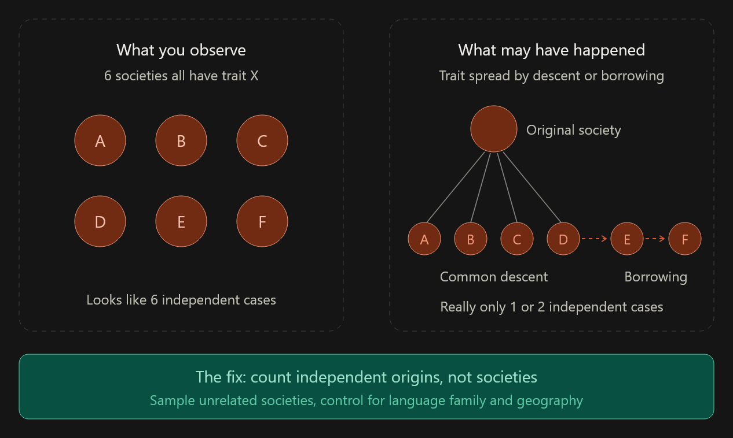
The Galton problem

Slide 15
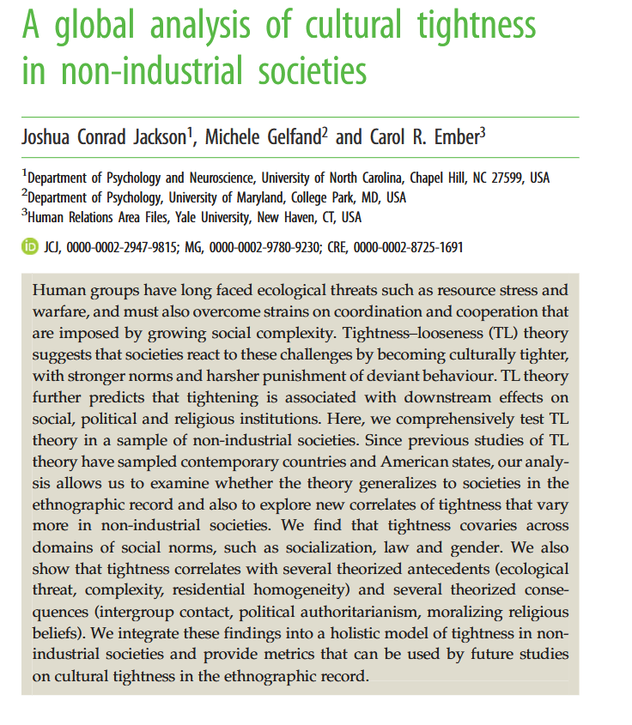
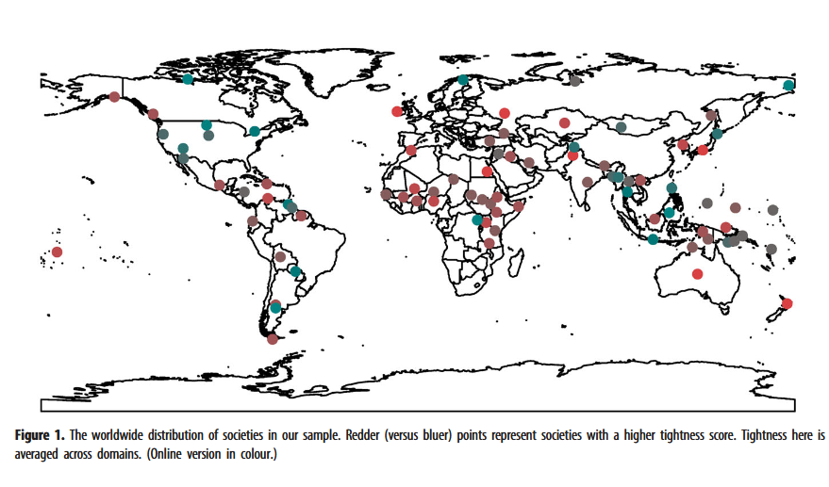
Societies can be tight (strong norms, harsh punishment of norm deviattion, norm monitoring…) or loose (the opposite).

Slide 16
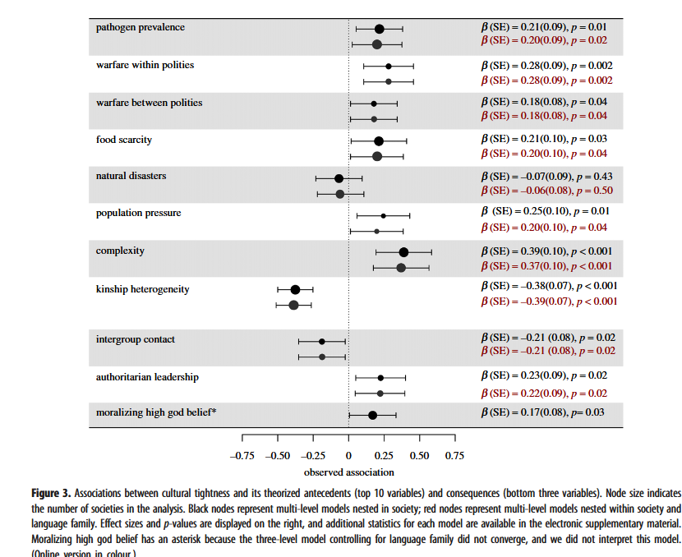

Slide 17
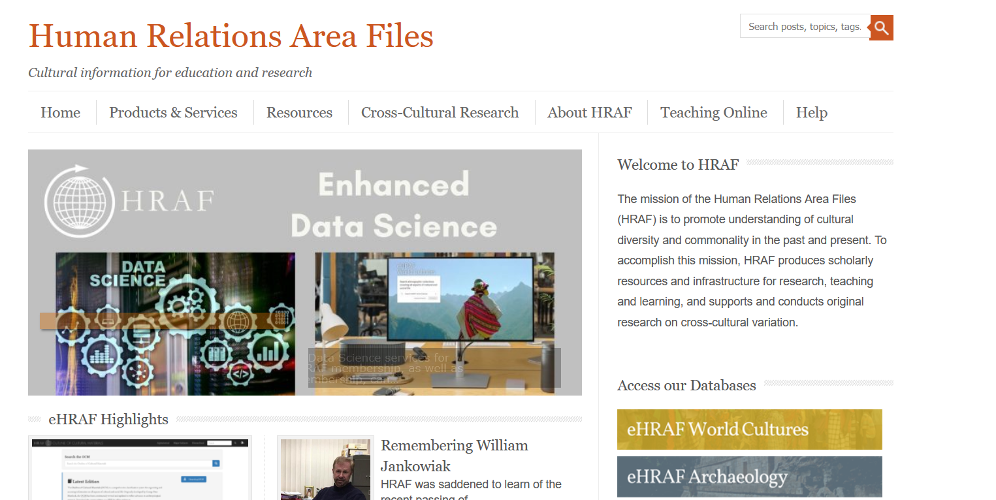

Slide 18
The limitations of extracting universal laws?

